Slide 1
Computer network session 06
Cloud computing
Santoso Budiijono

Slide 2
Cloud Computing
What is cloud computing?
Cloud computing is the on-demand delivery of IT resources over the Internet with pay-as-you-go pricing.
Instead of buying, owning, and maintaining physical data centers and servers, you can access technology services, such as computing power, storage, and databases, on an as-needed basis from a cloud provider like Amazon Web Services (AWS).

Slide 3
Cloud Computing
Who is using cloud computing?
Organizations of every type, size, and industry are using the cloud for a wide variety of use cases, such as data backup, disaster recovery, email, virtual desktops, software development and testing, big data analytics, and customer-facing web applications.
For example, healthcare companies are using the cloud to develop more personalized treatments for patients.
Financial services companies are using the cloud to power real-time fraud detection and prevention.
And video game makers are using the cloud to deliver online games to millions of players around the world.

Slide 4
Benefits of cloud computing
Agility
The cloud gives you easy access to a broad range of technologies so that you can innovate faster and build nearly anything that you can imagine.
Elasticity
With cloud computing, you don’t have to over-provision resources up front to handle peak levels of business activity in the future. Instead, you provision the amount of resources that you actually need
Cost Savings
The cloud allows you to trade capital expenses (such as data centers and physical servers) for variable expenses, and only pay for IT as you consume it
Deploy globally in minutes
With the cloud, you can expand to new geographic regions and deploy globally in minutes. For example, AWS has infrastructure all over the world, so you can deploy your application in multiple physical locations with just a few clicks

Slide 5
Type Of Cloud Computing
Infrastructure as a Service (IaaS)
IaaS contains the basic building blocks for cloud IT. It typically provides access to networking features, computers (virtual or on dedicated hardware), and data storage space.
Platform as a Service (PaaS)
PaaS removes the need for you to manage underlying infrastructure (usually hardware and operating systems), and allows you to focus on the deployment and management of your applications.
Software as a Service (SaaS)
SaaS provides you with a complete product that is run and managed by the service provider. In most cases, people referring to SaaS are referring to end-user applications (such as web-based email).

Slide 6

Cloud Service
IaaS
(infrastructure as a service)
PaaS
(platform as a service)
SaaS
(software as a service)
More control
over IT resources
Less control
over IT resources

Slide 7
Amazon Web Services
In this course we use Amazon EC2 (Elastic Compute Cloud)
  Amazon Elastic Compute Cloud (Amazon EC2) provides scalable computing capacity in the Amazon Web Services (AWS) Cloud. Using Amazon EC2 eliminates your need to invest in hardware up front, so you can develop and deploy applications faster.
  We can use Amazon EC2 to launch as many or as few virtual servers as you need, configure security and networking, and manage storage. Amazon EC2 enables you to scale up or down to handle changes in requirements or spikes in popularity, reducing your need to forecast traffic.

Slide 8
Feature AWS EC2
Amazon EC2 provides the following features:
Virtual computing environments, known as instances
Preconfigured templates for your instances, known as Amazon Machine Images (AMIs), that package the bits you need for your server (including the operating system and additional software)
Various configurations of CPU, memory, storage, and networking capacity for your instances, known as instance types
Secure login information for your instances using key pairs (AWS stores the public key, and you store the private key in a secure place)
Storage volumes for temporary data that's deleted when you stop, hibernate, or terminate your instance, known as instance store volumes
Persistent storage volumes for your data using Amazon Elastic Block Store (Amazon EBS), known as Amazon EBS volumes
Multiple physical locations for your resources, such as instances and Amazon EBS volumes, known as Regions and Availability Zones

Slide 9
Feature AWS EC2
Amazon EC2 provides the following features:
A firewall that enables you to specify the protocols, ports, and source IP ranges that can reach your instances using security groups
Static IPv4 addresses for dynamic cloud computing, known as Elastic IP addresses
Metadata, known as tags, that you can create and assign to your Amazon EC2 resources
Virtual networks you can create that are logically isolated from the rest of the AWS Cloud, and that you can optionally connect to your own network, known as virtual private clouds (VPCs)

Slide 10
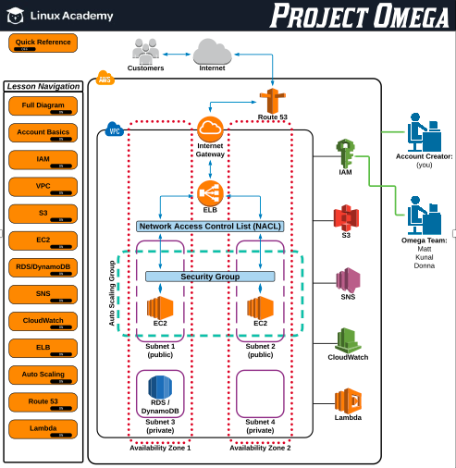
AWS overview product

Slide 11
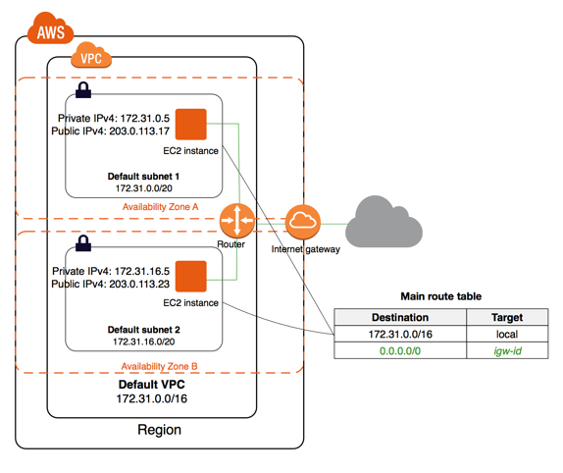
Example of AWS EC2

Slide 12
Example of AWS EC2

Slide 13
EXERCISE
Mention 5 core products in Cloud systems (AWS)?

Slide 14
References
Forouzan, B. A. (2021). Data Communications and Networking with TCP/IP Protocol Suite. 6th Ed. New York: McGraw-Hill. ISBN: 978-1-26-436335-3.
https://aws.amazon.com/what-is-cloud-computing/?nc1=f_cc

Slide 15
Thank you
December 2024

